Slide 1



Capstone 2
View in Power BI
Last data refresh:
10/30/2022 5:56:12 AM UTC
Downloaded at:
10/30/2022 6:33:32 AM UTC

Slide 2
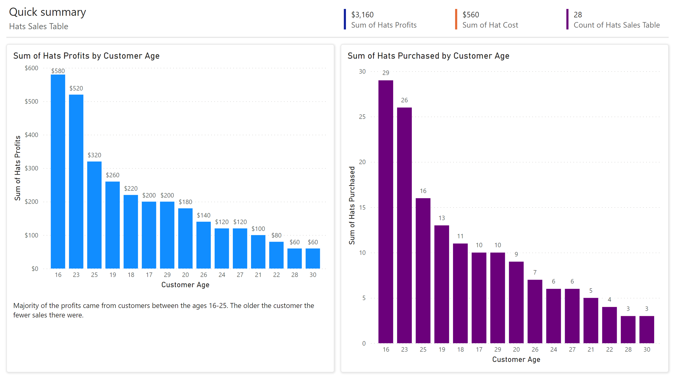
Page 1
Notes:
multiRowCard
No alt text provided
multiRowCard
No alt text provided
multiRowCard
No alt text provided
columnChart
No alt text provided
lineClusteredColumnComboChart
No alt text provided
shape
No alt text provided
textbox
No alt text provided
shape
No alt text provided
textbox
No alt text provided
textbox
No alt text provided
shape
No alt text provided

